Slide 1

Covid-19 Vaccines Efficacy
Sashidhar Bezawada

Slide 2

AGENDA
Introduction
Analysis
Vaccine Categories
Vaccine Effectiveness
US Covid-19 Vaccine Distribution by State
Vaccines Components
COVID-19 Vaccine Efficacy
COVID-19 Vaccine common side effects
U.S. COVID-19 Vaccine Adverse Effects - Pfizer vs Moderna
COVID-19 Vaccine - A study by CDC
COVID-19 Vaccine - Interest Over time
Ethics
Challenges and Opportunities
Conclusion
References

Slide 3
Introduction
Coronavirus disease (COVID-19) is an infectious disease caused by the SARS-CoV-2 virus. Most people infected with the virus will experience mild to moderate respiratory illness and recover without requiring special treatment.
COVID-19 vaccination will help protect you by building immunity without the risk of severe illness and vaccination is one measure to help stop the pandemic.
The project aims to convey the analysis of different ongoing vaccination programs within United States of America by using all publications, reports, and news articles and review all available data to find how effective vaccines are at achieving multiple outcomes.
The objectives for the following project to prove there is no best vaccine. All the vaccines are effective, particularly at preventing serious disease. Because trials were conducted differently at different times, effectiveness figures cannot be directly compared.

Slide 4
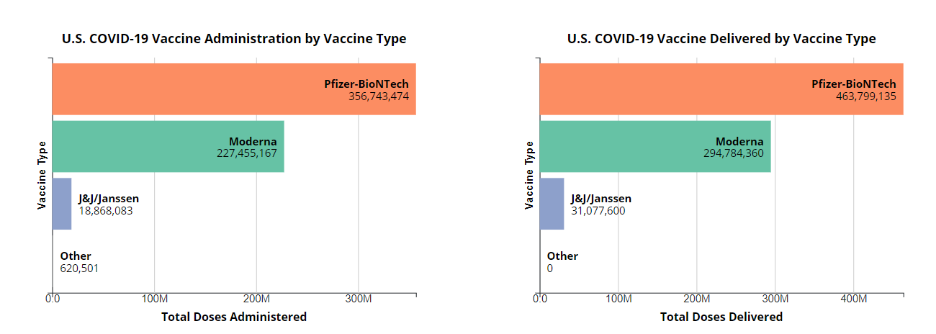
Vaccine Categories
Inference: As per the charts above, Pfizer vaccines numbers administered are high, compare to Moderna and Janssen. As per the second chart Pfizer has got more doses delivered, that explains why we see pfizer is widely administered vaccine in USA. Pfizer/BioNTech has gained more popularity due to its better manufacturing capabilities abilities, so they are making more vaccines and the same is procured and distributed by US Federal government to all its jurisdictions

Slide 5
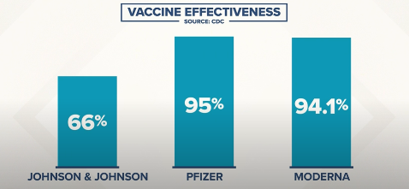
U.S. COVID-19 Vaccine Effectiveness
As per the clinical trials done by the respective vaccine companies and also as quoted by Dr. Linda Bell, State Epidemiologist for South Carolina's Department of Health and Environmental Control in an interview with WCNC, it is unfair to compare vaccine efficacy from scientific standpoint as they were tested in different points in time. They were tested in different populations of people when there were different strains circulating in those different populations of people.

Slide 6
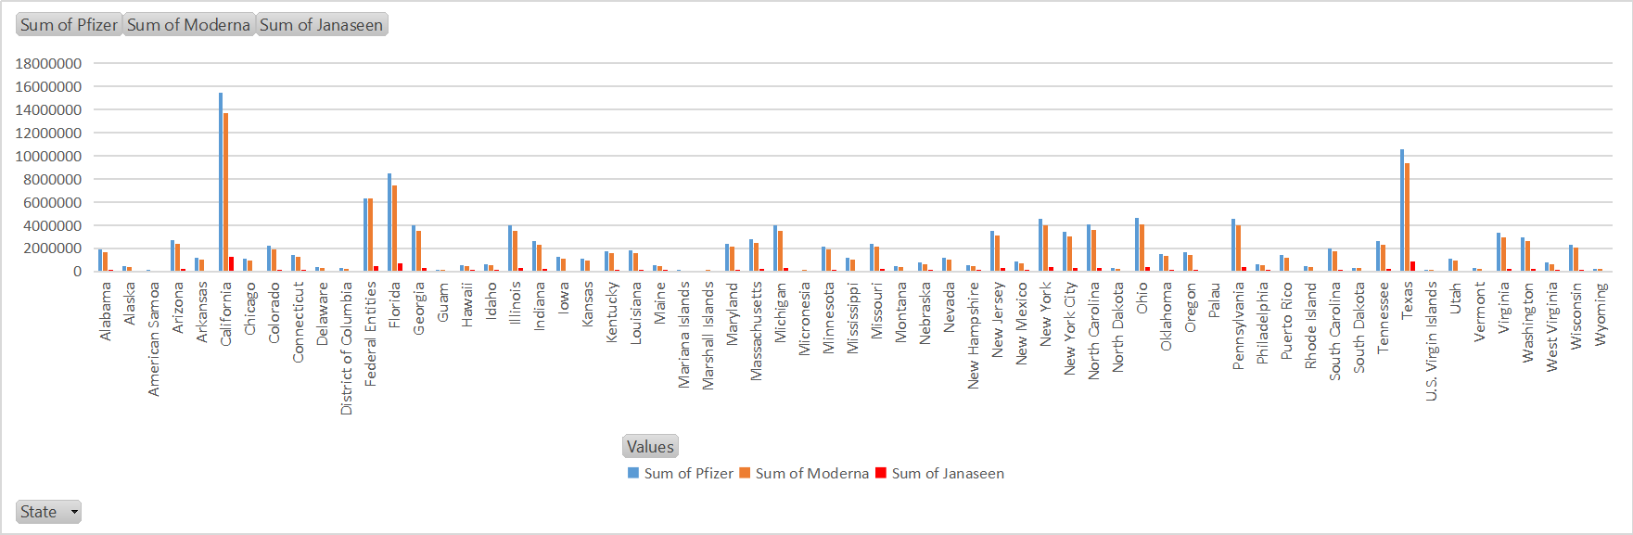
US Covid-19 Vaccine Distribution by State
Inference: As per FDA briefings, it is approved Pfizer-BioNTech on Dec 10,2020 and Moderna on Dec 17,2020 for emergency use. Hence it is evident that the testing done possibly on different strains circulating in those different populations of people.
Pfizer and Moderna are distributed to states by federal government hence you see the # of people vaccinated with Pfizer and Moderna are more. Pfizer distribution started on 12/14/2020, Moderna on 12/21/2020 where as Jansen is March 2021. Also news about blood clotting events for Jansen has kept the distribution on hold. Between Pfizer and Moderna, Pfizer has more numbers and make it popular

Slide 7
Vaccines Components
The vaccines developed by Pfizer-BioNTech and Moderna take advantage of messenger RNA (mRNA), which instructs cells to produce a protein on the surface of the virus. The immune system recognizes those vaccine-triggered spike proteins as invaders and creates antibodies to block future attacks of the virus that causes COVID-19.
Moderna’s vaccine uses 100 micrograms of RNA per dose, while Pfizer-BioNTech’s shot uses only 30 micrograms making it easier to produce and less expensive. That should enable Pfizer-BioNTech to increase production of their vaccine more quickly than Moderna which is evident pfizer vaccinated population is more than others in USA.

Slide 8
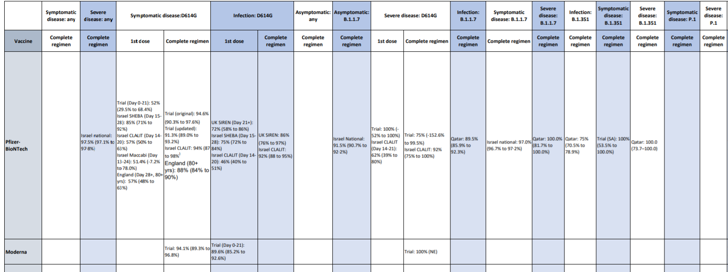
COVID-19 Vaccine Efficacy
Data available today consist of clinical trials and several quasi-observational studies
Based on the published details, it is evident that Pfizer has more studies done on multiple variants and overall efficacy rate of 95% which probably is one of the key factors to gain people confidence thus reducing hesitancy rate among people of United states of America.

Slide 9
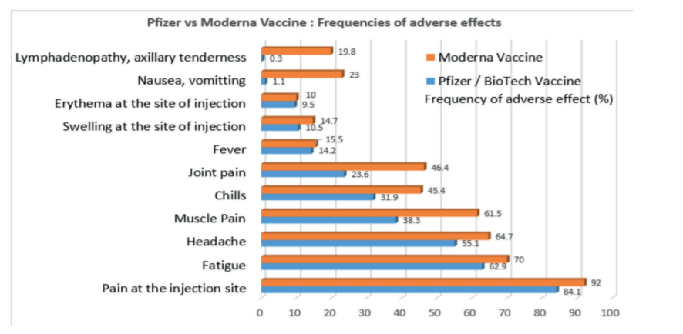
COVID-19 Vaccine common side effects
The percentage of these adverse effects is reported to be lower with the Pfizer/BioNTech vaccine than with the Moderna vaccine, however the Moderna vaccine compared to the Pfizer
vaccine is easier to transport and store because it is less temperature sensitive.
It must be noted that because clinical trials are conducted under widely varying conditions, adverse reaction rates observed in the clinical trials of a vaccine cannot be directly compared with rates in the clinical trials of another vaccine and may not reflect the rates observed in practice.

Slide 10
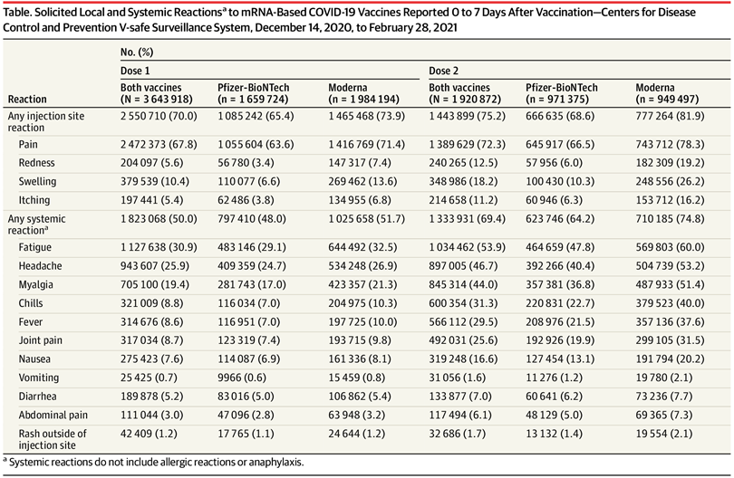
U.S. COVID-19 Vaccine Adverse Effects – Pfizer vs Moderna
Individuals who receive the Moderna vaccine are more likely to experience post-vaccine reactions and side effects, new data from the U.S. Centers for Disease Control and Prevention (CDC) show (table).
A greater percentage of participants who received the Moderna vaccine, compared with the Pfizer-BioNTech vaccine, reported reactogenicity; this pattern was more pronounced after the second dose.

Slide 11
COVID-19 Vaccine - A study by CDC
The recent study done by CDC among health health care personnel, first responders, and other essential workers aim to look at the effectiveness of Pfizer-BioNTech and Moderna mRNA vaccines in preventing Covid infections among 3,950 study participants in six states over a 13-week period from December 14, 2020 to March 13, 2021.
Results showed that following the second dose of vaccine (the recommended number of doses), risk of infection was reduced by 90 percent two or more weeks after vaccination. Following a single dose of either vaccine, the participants’ risk of infection with SARS-CoV-2 was reduced by 80 percent two or more weeks after vaccination.

Slide 12
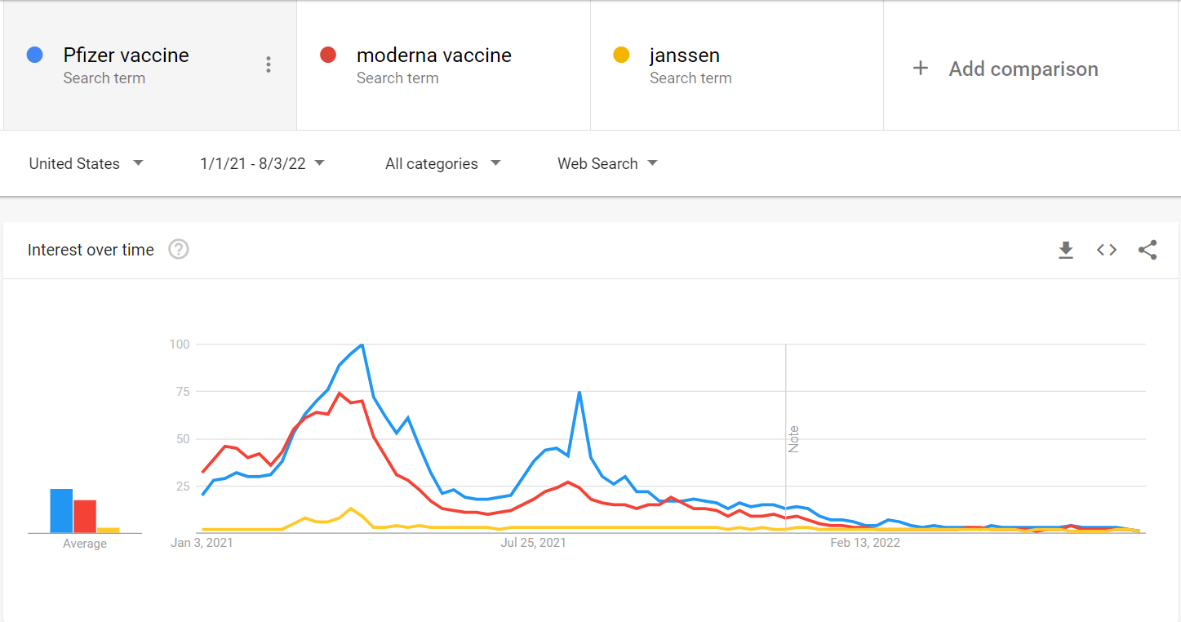
COVID-19 Vaccine - Interest Over time
Based on the google trends data, pfizer stood out as most searched over others and searched in most of the states in USA.

Slide 13
Ethics
In this study, I have used the publicly available information on coronavirus, COVID-19 vaccine, Pfizer/BioNTech and Moderna vaccines; hence, Ethical approval is not required.

Slide 14
Challenges and Opportunities
New Viral variants may pose great challenges to current vaccines
Although the protection of current vaccines against variants has declined to various degrees, they are still higher or close to the level of protection defined by the WHO of at least 50%. The vaccine is very effective against severe, critical or fatal diseases caused by Covid-19.
COVID-19 vaccine hesitancy in the US throughout the pandemic has revealed inconsistent results.

Slide 15
Conclusion
Covid-19 vaccines can protect recipients from a Covid-19 infection by formation of antibodies and provide immunity against a Covid-19 infection. Though based on number of vaccines administered in USA, Clinical trials observation, Efficacy rate, adverse effects, google trends - it is natural for one to believe Pfizer is more effective but scientifically it is unfair to compare as they were tested in different points in time. They were tested in different group of people when there were different strains circulating in those different group of people.
Both vaccines can cause various adverse effects, but these reactions are reported to be less frequent in the Pfizer/BioNTech vaccine compared to the Moderna COVID-19 vaccine; however, the Moderna vaccine compared to the Pfizer vaccine is easier to transport and store because it is less temperature sensitive. Also please note the efficacy rates, observations studies from trails done not the actual people vaccinated as of today. Bases on all these factors, I conclude it is difficult to decide which one is better.

Slide 16
References
COVID Vaccines Compared , Medically Reviewed by Carol DerSarkissian, MD on March 20, 2022 https://www.webmd.com/vaccines/covid-19-vaccine/covid-vaccines-compared
STOP COVID-19 CA website: https://www.stopcovid-19ca.org/
NIH CEAL (Community Engagement Alliance) Against COVID-19 Disparities website: https://covid19community.nih.gov/
CDC COVID-19 Vaccine Communications Toolkit for CBO: https://www.cdc.gov/coronavirus/2019-ncov/vaccines/toolkits/community-organization.html
CDC COVID-19 website: https://www.cdc.gov/coronavirus/2019-ncov/index.html
ASTHO (Association of State and Territorial Health Officials) COVID-19 website: https://astho.org/COVID-19/
www.nejm.org/doi/full/10.1056/NEJMoa2034577
www.nejm.org/doi/full/10.1056/NEJMoa2101765
www.nejm.org/doi/full/10.1056/NEJMc2104974
www.thelancet.com/journals/lancet/article/PIIS0140‐6736(21)00448‐7/fulltext
www.thelancet.com/journals/lancet/article/PIIS0140‐6736(21)00947‐8/fulltext
www.papers.ssrn.com/sol3/papers.cfm?abstract_id=3790399
www.medrxiv.org/content/10.1101/2021.01.27.21250612v1
www.assets.publishing.service.gov.uk/government/uploads/system/uploads/attachment_data/file/963532/COVID‐19_vaccine_effectiveness_surveillance_report_February_2021_FINAL.pdf
https://www.pfizer.com/news/press‐release/press‐release‐detail/pfizer‐and‐biontech‐confirm‐highefficacy‐and‐no‐serious

Slide 17
Challenges and Opportunities
THANK YOU

